Slide 1
Complex Adaptive Systems
Emotions & Moods on Society
Summary – April 20, 2010
Christine Talbot
Master’s Student

Slide 2
Overview
One current theory of how moods & emotions affect us is through emotion contagion.
This is where each of us have the ability to “infect” others with our own emotions, depending on the emotion, the energy level of the emotion being presented, and how open we are to receive / transmit feelings.
The tendency is for the masses to copy each other’s behaviors and emotions.
Managers & team leaders or other people with dominance roles tend to be more contagious with their emotions than others.
Women tend to be the recipient of this contagion effect more often than men.
And, overall, people tend to be attracted to similar emotions as they are feeling.

Slide 3
Goals
Identify whether society will migrate towards one emotion/mood over others, or will balance out
Identify if these similarly-feeling people will form a close-knit group (via proximity) or not

Slide 4
System parameters
Agents
Men (attribute)
Women (attribute)
Number determined by slider bar
% Men vs Women controlled by slider bar
Environment
Open
Introduces impacts of outside events that can affect emotions / moods
A button to add system-wide events
Random mutation capabilities of attributes

Slide 5
Agent attributes
Agents will have the following attributes, each which can be turned on / off via a toggle to assist with analysis of different combinations:
Openness
This is how likely the person is to mimic someone else’s emotions & may change over time due to mutation
Current emotion
This is a 0-60 range that is split into buckets to represent some “basic” emotions, such as:
Joy, Love, Neutral, Sadness, Fear, Anger – Changes with interactions, landing on patches, or event invocations
Each emotion is represented by a different color
Dominence scale
This determines if there is any hierarchy of people & is used to simulate a manager vs reportee impact on emotion contagions – is relatively static for the life of the agent, with some mutation possible
Current emotion’s energy level
This varies with every step of the timer or change of emotion, and affects the person’s likeliness to impact another agent’s emotions

Slide 6
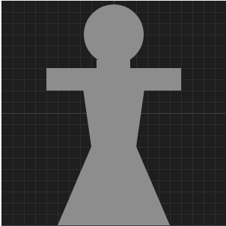
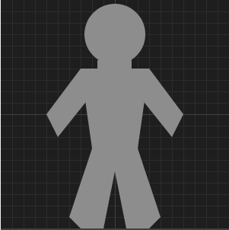
Agent attributes (cont)
Gender
This differentiates the agents primarily in the openness values for the agent
The agents are differentiated by picture:
Women
Men

Slide 7
Patch attributes
Subset of patches have emotion
Controlled by slider
Changes with each tick of the clock
Simulates local “events” that can affect an agent’s emotions
Each patch with an emotion is colored a grayed-version of the colors used for the agents’ emotions
Emotion
Similar to the agent’s moods – a continuum / range split into “buckets”
Emotion Energy
How strong the emotion is (affects how likely the agent on the patch will be impacted)

Slide 8
Agent behaviors
Agents move towards other agents within their visibility (locality and peripheral vision range) who have the emotion closest to theirs, with some randomness included
Upon interaction, based on their dominence, gender, current emotion, and energy level (if all turned on), the agents adjust their current emotion, with some randomness included
The patch the agent lands on also affects the agent’s mood, with some randomness, if the patch has an event-emotion tied to it at that time
Global “events” affect the agent’s emotions, with some randomness

Slide 9
Other details
The information shared in this system is primarily around moods & emotions.
The feedback loop is how high on the emotional scale they are.
The “energy” of the system is the moods of the agents.
Locality & Angle are sliders for immediately next-to vs larger visibility ranges for movement, as well as peripheral control of who is visible
The fitness function is how positive or negative the agent’s mood is, as well as the cumulative view of all agents’ moods.

Slide 10
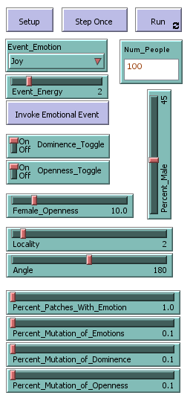
System PARAMETERS
resets the world & creates the agents, their attributes, and patches, initialized
runs step continually
identifies how many people to create in the world (only applied when you click Setup)
runs one tick of events
Event_Emotion - drop down to choose the emotion to incur when you click the Invoke Event button (only applied upon clicking Invoke Event button) Event_Energy - slider to choose a value from 0-10 for how strongly the emotion should be evoked when you click the Invoke Event button (only applied upon clicking Invoke Event button) Invoke Event button - Invokes an event of Event_Emotion & Event_Energy to all the agents in the system
slider to choose percentage of male vs female agents to create (only applied when you click Setup)
Dominence_Toggle - turns on / off the effects of the dominence trait in the system for applying emotions upon interactions & events Openness_Toggle - turns on / off the effects of the openness trait in the system for applying emotions upon interactions & events
Used to determine how much more likely women are to be open than men (only applied when you click Setup)
Locality - determines how far away an agent can see, in order to look for another agent with similar emotions to move towards Angle - determines the visible arc in front of a person (ie peripheral vision) that they can see, in order to look for another agent with similar emotions to move towards
Percent_Patches_With_Emotion - determines what percentage of patches should represent a local emotional event (is applied with each tick) Percent_Mutation_of_Emotions - determines what percentage of agents at each tick should randomly "mutate" their emotion, regardless of whether there is any interaction or event incurred
Percent_Mutation_Dominence - determines what percentage of agents at each tick should randomly "mutate" their dominence, to simulate rises & falls of hierarchy Percent_Mutation_Openness - determines what percentage of agents at each tick should randomly "mutate" their openness, to simulate changes due to experiences

Slide 11
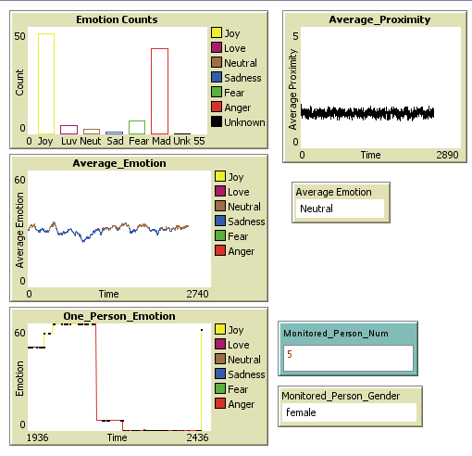
GRAPHS
shows a bar graph of all agents bucketed into their emotions
shows how close agents are to each other (closest agent is used)
Need to add another graph for how similar (on average) each agent is to their closest neighbor)
graph of the average emotion of all agents over time - vertical pink lines are global events that are occurring
Average_Emotion - shows the name of the average emotion of all agents currently
Monitored_Person_Num - who # of the person you want to monitor the emotions for (will clear graph if you change this mid-run)
Monitored_Person_Gender - gender of the person with who = Monitored_Person_Num
One_Person_Emotion Graph - graph of the monitored person's emotion over time - vertical pink lines are global events that are occurring, and black dots are when the agent is interacting with another agent

Slide 12
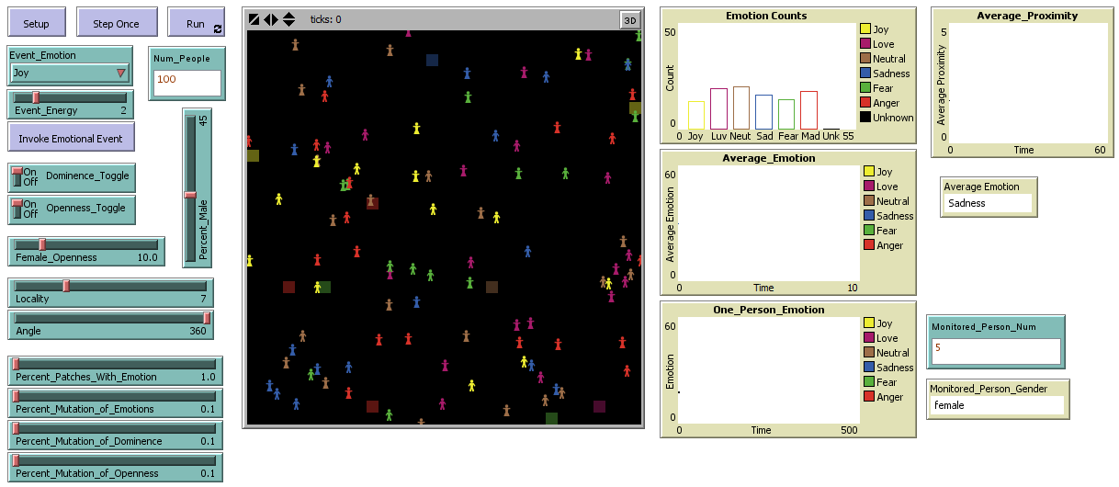
SYSTEM

Slide 13
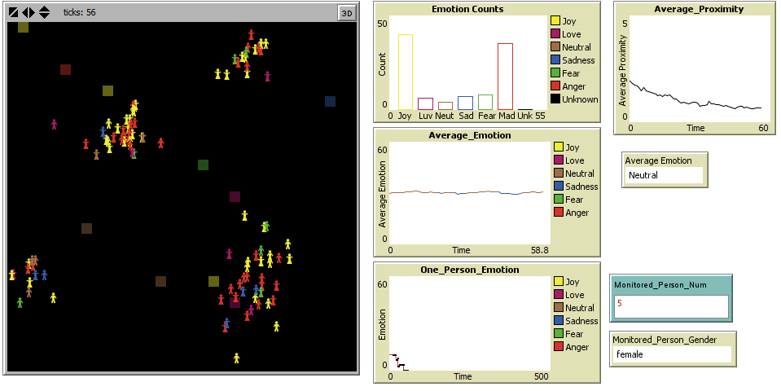
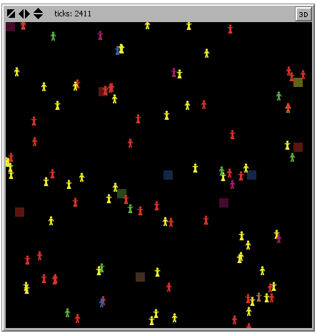
SYSTEM screenshots
Results of running with Locality = 7, Angle = 360
SETUP

Slide 14
Things to notice
If you increase the visibility range for the agents, you'll notice that they flock together. Lower visibility ranges do not cause any flocking.
Also, if you invoke an event, not all people are affected, it may take several invokations in order to get everyone to align with that event's mood.
A single person's emotions can vary drastically & spike from one extreme to the other. This may be due to the patches having events & affecting the person.
Oddly enough, most of the agents tend to end up having either Joy or Anger emotions, and very few inbetween.
If you set Locality = 7 & Angle = 360, you can get clusterings of people (I got 4 clusters based upon the point in time where I made the change from a previously started run). This clustering merged into 3 groups after running a little longer with the same settings & when run long enough, incurred a single clustering of agents.

Slide 15
Potential enhancements
Might want to try allowing opposing emotion, better application of emotions, using the energy of the emotion to trigger, allowing for the reverse emotion to occur, moving towards happier people if no one is similar to them (how similar? add a slider?), etc.
Add a spot on the graphs to show when the single person met someone vs the event invocation vs the patch influence.
Add graph for how similar the closest person is to each agent.
Might add ability to color agents based on dominence, openness, energy, OR emotion with a click of a button?
Allow patches to be colored (or not) based on a toggle
Highlight the person being monitored based on a toggle?
Allow people to move towards closest person, but not past if moving towards them

Slide 16
Netlogo features used
Use of in-cone for providing only locality within peripheral & in-front of person visibility.
Manually plotting "histogram" to show bar charts over time
Ability to track one person's emotions over time
Turned off world wrapping

Slide 17
Questions?

